Slide 1
Budget integration platforms for China 2024
Andrej Zwierzak

Slide 2
China monthly cost SEK
China monthly cost | Streaming (Min – Max) | Wso2 (Min – Max) | EMQX | Total year (Min – Max)
Manged Service Fixed | 201 000 | 69 000 | 80 000
Manged Service Flexi 100h APIM 150h Confluent | 0 – 45 360 | 0 – 24 640 | 0 – 30 000
License | Excluded | 80 500 | Excluded
AWS Cost | 155 000 - 221 850 | 38 420 | 160 000
Datadog Cost | 13 000 - 18 700 | 13 000 - 18 700 | 13 000 - 18 700
Total | 414 360 - 486 910 | 225 560 - 231 260 | 283 000 - 288 700 | 11 075 040 - 12 082 440
Nr of Applications | 17 | 24 | 1 (5)
China direct cost Year | SEK
Confluent platform | 2 974 000 - 6 000 000
EMQX | 800 000
Seeburger EDI SaaS service cost in China will
be taken by China logistic

Slide 3
Cost model
Year 1
Year 2
Year 3
Year 4
Year 5
Lose 30%
Lose 20%
Lose 10%
Break even 0%
Profit 10%
Producer
Gold 15 000
Silver 14 000
Bronze 13 000
Producer
Gold 15 000
Silver 14 000
Bronze 13 000
Producer
Gold 15 000
Silver 14 000
Bronze 13000
Producer
Gold 15 000
Silver 14 000
Bronze 13000
Producer
Gold 15 000
Silver 14 000
Bronze 13000
Consumer
Gold 15 000
Silver 14 000
Bronze 13 000
Consumer
Gold 15 000
Silver 14 000
Bronze 13 000
Consumer
Gold 15 000
Silver 14 000
Bronze 13 000
Consumer
Gold 15 000
Silver 14 000
Bronze 13 000
Consumer
Gold 15 000
Silver 14 000
Bronze 13 000
6
6
6
Number of
customer
Number of
customer
Number of
customer
Number of
customer
Increase number of customer
Increase Load cost

Slide 4
Business plans per tenant
Plans | Cluster Produce Quota (kb/S) | Cluster Consume Quota (kb/S) | Capacity Retention (GB) | Max Partition Available | CPU Quota (% of total CPU time)
Gold | 4096 | 16384 | 64 | 960 | ?
Silver | 512 | 2048 | 32 | 480 | ?
Bronze | 64 | 256 | 4 | 240 | ?
These plans vary primarily on the following dimensions
Produce and consume quotas (throughput rate)
Capacity (the total amount of data that can be retained at a time)
The maximum number of partitions allowed per topic
CPU quotas for KSQL, Streams, Flink

Slide 5
Common defaults for plans
Max number of partition per topic: 256
Default number of partitions: 8
Min retention: 1 day
Max retention: 7 day
Max messages size: 1 MB
Max number of topics per Add-on: 40

Slide 6
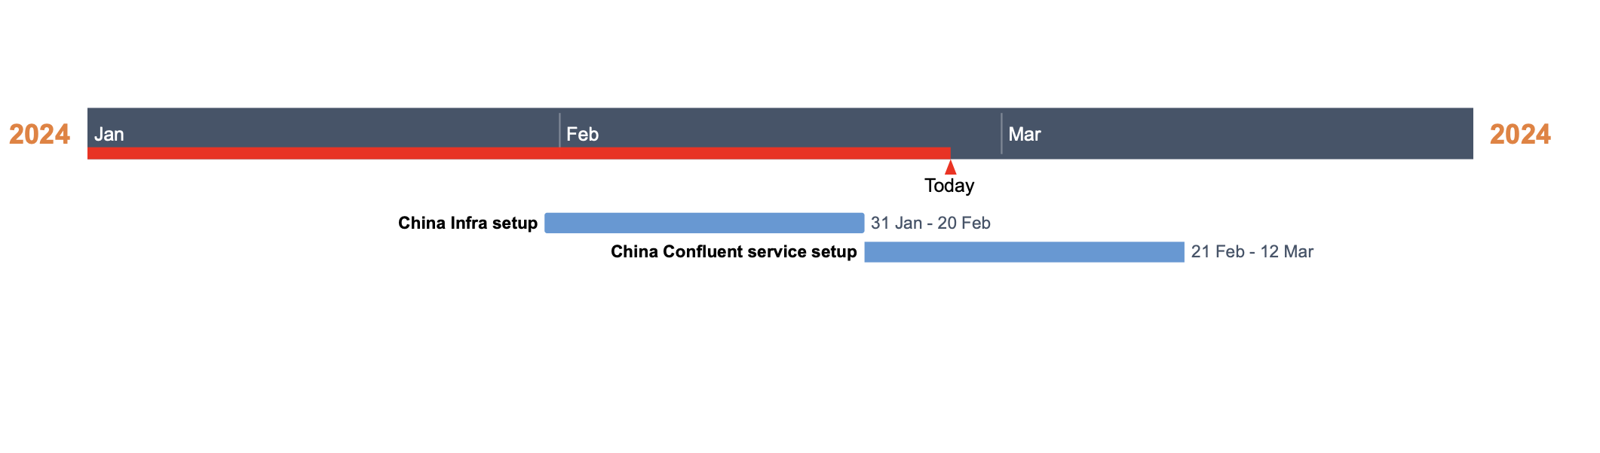
China Greenfield status
AWS infrastructure setup is complete.
Confluent Services setup in ongoing in this sprint.
China greenfield environment should be ready by mid-March
China Production should be ready in late April(Depending when we get Enablement account)

Slide 7
Considerations for Kafka quotas
Enforcement level : Quotas are enforced at the broker level not cluster level. If you have six brokers in a Kafka cluster and you specify a 12 MB/sec produce quota for a client ID, you can produce a max of 72 MB/sec across all six brokers.
Throttling: When an application reaches its quota, it is throttled, not failed, meaning the broker doesn’t throw an exception.
Shared quotas: If more than one client application has the same client ID and user, the quota configured for the client ID and user will be shared among all those applications.

Slide 8
Why Quotas in Kafka
Quotas in Kafka are used to control and limit resources for different clients.
They ensure fair resource usage and prevent a single client from dominating the cluster.
Quotas help manage and allocate resources effectively in multi tenancy Kafka environments.
Prevents misbehaving or resource-intensive clients from impacting overall cluster performance (limit resource utilization).
Contributes to stability, fairness, and efficient resource utilization in Kafka.
Distribute cost model based on resource utilization

Slide 9
Questions
How can we distribute business plan per tenant?
Can we only set quotas on Client id or user?
Do we need to have number of client id per business plan?
How can we describe cost model so customer understand what he is signing for?

Slide 10
Quotas
Consumer throttle (Network bandwidth quota): This quota allows you to limit the amount of data a consumer can retrieve from the Kafka cluster per second. Setting a maximum network throughput prevents any single consumer from using excessive network bandwidth.
Producer throttle (Network bandwidth quota): Similar to the consumer throttle, this quota limits the amount of data a producer can send to the Kafka cluster per second. It ensures that producers do not overload the system by sending excessive data, thereby maintaining system stability.
CPU throttle: This quota is about managing CPU usage. You can manage CPU usage by setting a percentage of the total CPU time. Limiting the CPU resources for specific client IDs or users prevents any individual from monopolizing CPU resources, promoting fairness and efficient resource utilization.

Slide 11
Budget in EU
APIM
Shared cost as Infrastructure
Streaming
Service cost distributed directly to customer
EMQX
50 % Shared cost and 50 % P&L

Slide 12
Budget in China
All costs in China will not be distributed for first 1,5 year
The cost will be added to total cost for China.
We don’t need to invoice any costumers…….

Slide 13
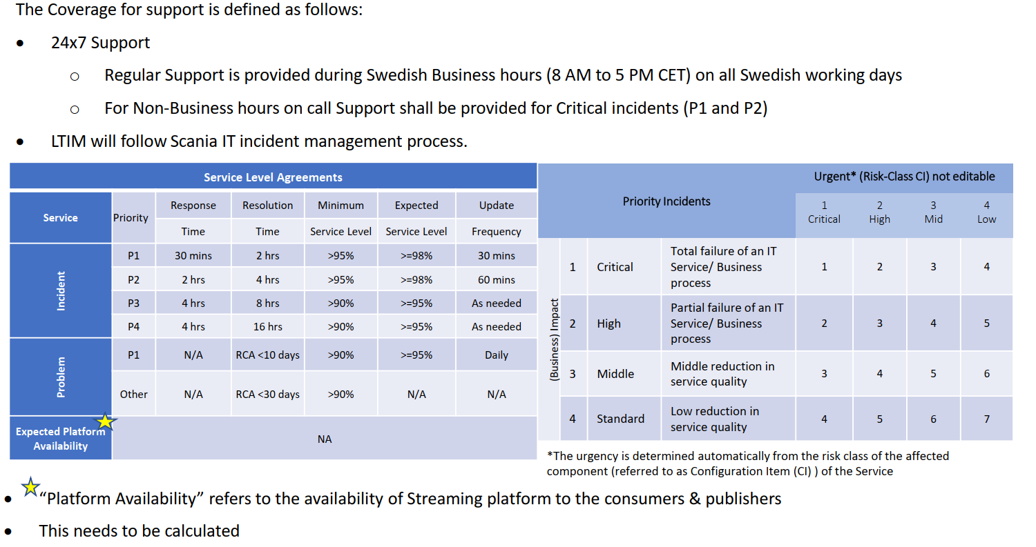
Support and SLA (3 months calibration)

Slide 14
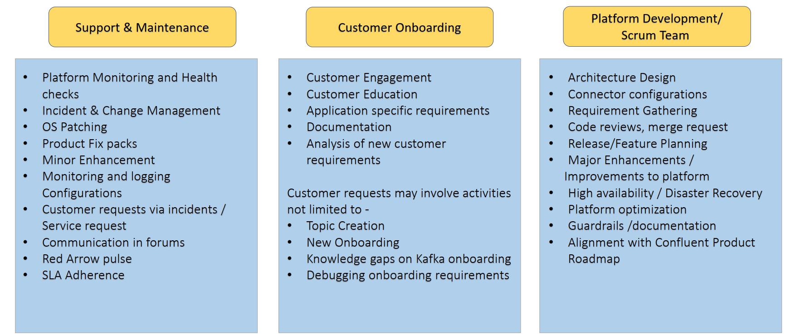
Rules and responsibilities

Slide 15
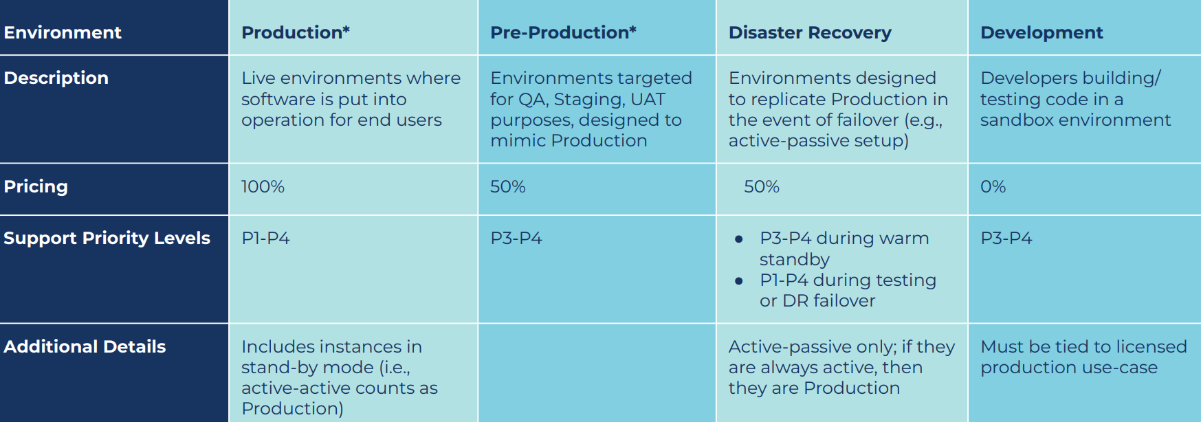
Pricing matrix for licences

Slide 16
Answer from Streaming
Whish application, Customers are using Streamin Platform today in EU?
Please check attached XL sheet
Do we know which application will use Streaming Platform in China
OAS, SAP, CATIA, Datalake, Ebba, Battery factory (IEB), Mona, Sparta IBM Maximo.

Slide 17
Answer from EMQX
Which application, Customers are using EMQX Platform today in EU?
Smart Maintenace (INFB), Simovo (AGV), Gas Tank, DE Press machine.
Outside EU - SLA Brazil (Platform is ready to use), Zwolle ( Platform setup in in progress)
Do we know which application will use EMQX in China?
Simovo (AGV) /Hero?
Potential Applications - DIDRIK, EBBA, Smart maintenance. IBM Maximo, PROMO & Asset Monitoring - Facilities

Slide 18
Answer from SEIP
How many application in SEIP are using PUB/SUB patten (Mqseries) in SEIP?
mostly it’s file based large messages, if they don’t do a redesign for event-based integration. then it only a few that will move to streaming.
Do we have a list on the applications?
I don’t have a list, because if they will go to file-based integrations then I don’t know which will use kafka.

Slide 19
Integration Transformation Strategy
We aim to shift IX from an integration factory to an integration enabler. We want to move from a central integration platform to decentralized integrations, which are developed and maintained by individual DevOps teams. IX shall provide central capabilities for integrations.
The long-term vision is to have distributed self-service integration platform services. These platforms should be developed based on the following principles:
Self-service
Support integration patterns across multiple delivery organizations
Distributed (Deployed for individual groups)
Maintained and enhanced by individual DevOps teams
Data sharing using standard, reusable interfaces
All reusable APIs to be published in Marketplace
The foundation will be the same in all Scania Sites.
All teams need to follow the API Strategy management have approved

Slide 20



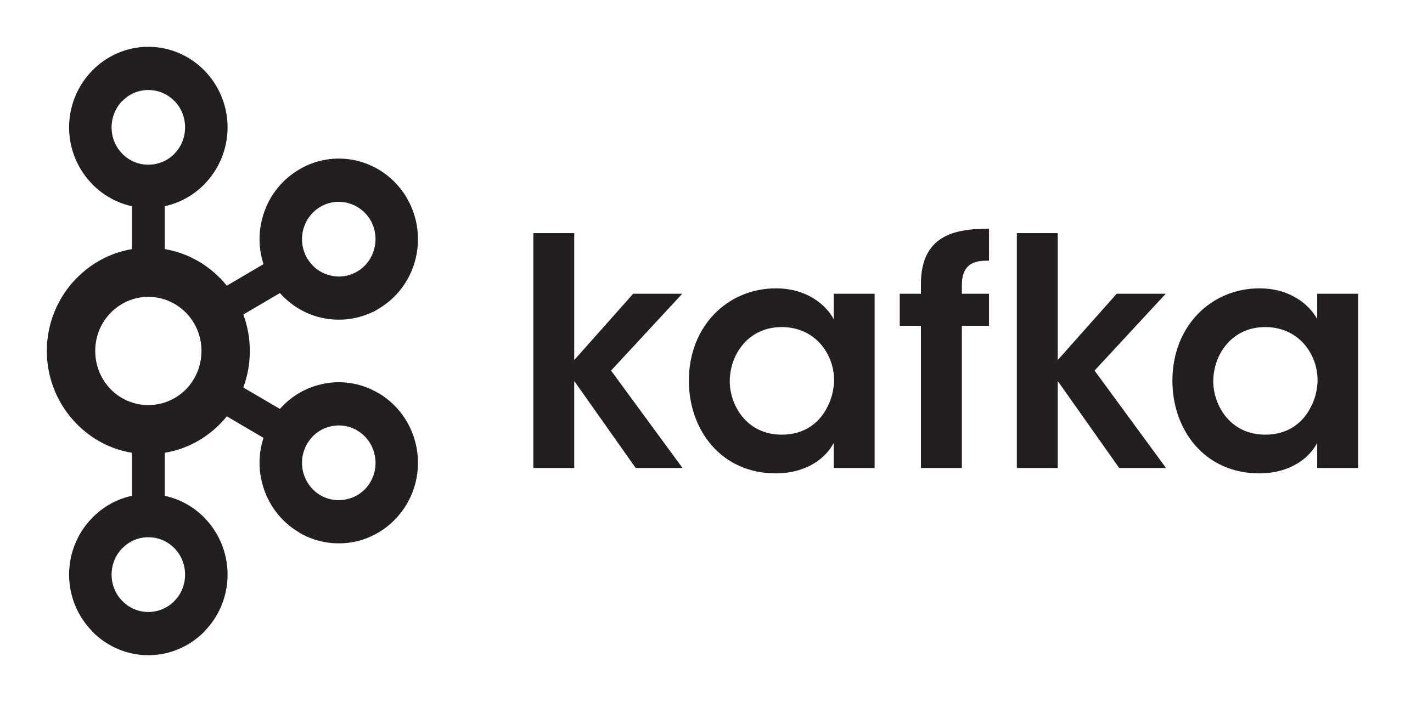

Integration Transformation Strategy (Vision)
The following picture represents our vision of the integration strategy.
From integration factoRy Integration enabler ( Light, flexible, Self-service)
Step 0
Step 1
Step 2
Step 3
SEIP
APIM /STREAM
Market Place
Market Place
SEIP
APIM / STREAM
SAAS
API GW
Shared component managed by IX
Integration component part of the platform, e.g. D365 or SAP
API GW
Other API gateways than APIM/WSO2, e.g. Amazon API Gateway

Slide 21
Invoicing Model (multi-tenant)
Cost | Publisher | Subscriber | Comment
Shared discount cost (Fixed) |  |  | Technical dept 30 % of all cost (customer
Base cost (fixed) | Only |  | For each team monthly cost
Producer Variable cost | Throttling |  | Unlimited, Gold, Silver Bronze based on transaction
Subscriber Variable cost |  | Throttling | Unlimited, Gold, Silver Bronze based on transaction

